Slide 1


Internship Showcase Presentation
Zhongruo Wang

Slide 2
Content
Project Overview
Data
Model Architecture
Performance

Slide 3
Content
Project Overview
Data
Model Architecture
Performance

Slide 4
Project Overview
Internship Objective:
Extract and incorporate signals from our behavioral data for our risk models.
Investigated SoFi Money measurement and transactions data.
Background and Context:
Our current implementation of customer risk model uses users’ credit, socure and aggregated transactions features to predict the likelihood an account being risky.
It is built with LightGBM (gradient boosting tree), which takes in tabular data.
Assumption: May obtain a performance lift by extract sequential signals from time series data.
Solution: Temporal Convolutional Network (TCN)
We built a TCN classifier that takes in sequential transactions data and predict a score reflecting the riskiness of an account. Then the score currently acts as an input feature for our current lgbm model.

Slide 5
Project Overview
Deliverable:
A customer risk model by combining TCN and LightGBM.
A generalized TCN classifier API in PyTorch.
Performance:
On OOT validation, for the top 5% of accounts which the models deem risky:
LGBM baseline captures 88.5% of risky accounts; false positive rate = 9.1%
TCN + LGBM captures 92.2% of risky accounts; false positive rate = 5.34%
Notes:
For top 5% of the predicted risky accounts,
TCN+LGBM captures 92% of the high risk accounts with 5.34% false positive rate
LGBM captures 88.5% of the high risk accounts with 9.1% false positive rate

Slide 6
Content
Project Overview
Data
Model Architecture
Performance

Slide 7
Data
Two dataset:
Target definition: at the current time, True if an user has exhibited high risk behaviors in the past.
Has charge offs
Has check bounces
Negative account balance
Targets are created on the account level, and we used the same target for transactions level.
dataframe | notes | neg : pos | length | n_borrowers
Account level | One row for each user for each day | 14:1 | 2,096,968 | 24158
Transactions level | Past transactions made by users | 19:1 | 817,174 | 23308
Notes:
Median transactions len per user: 11

Slide 8
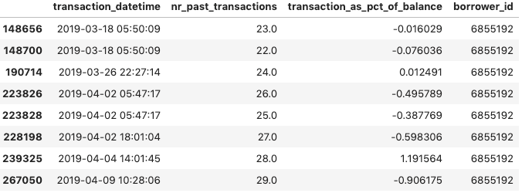
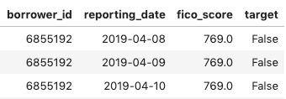
Example
Account level data
Transactions level data

Slide 9
Content
Project Overview
Data
Model Architecture
Performance

Slide 10
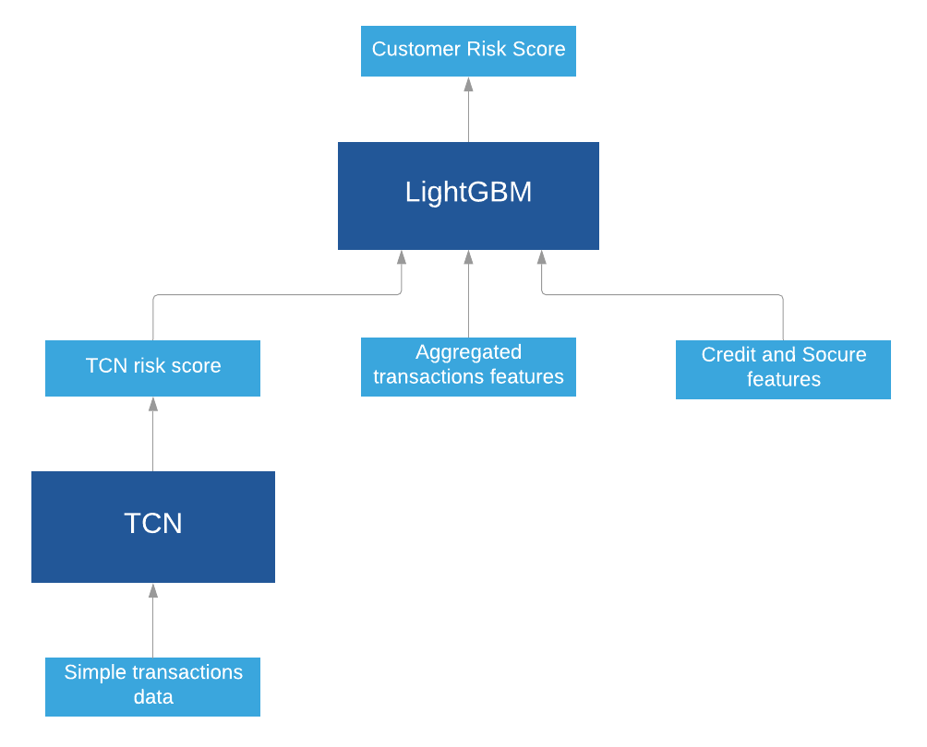
Model Architecture - TCN + LightGBM
Separate data into three categories:
credit and socure features - account level
aggregated transactions features
account level
simple transactions feature
transactions level
Calculate TCN risk score using simple transactions data
Calculate customer risk score using
TCN risk score
aggregated transactions features
credit features
Notes:
23 features for LightGBM
8 for TCN

Slide 11
Example
Account level data
Transactions level data

Slide 12
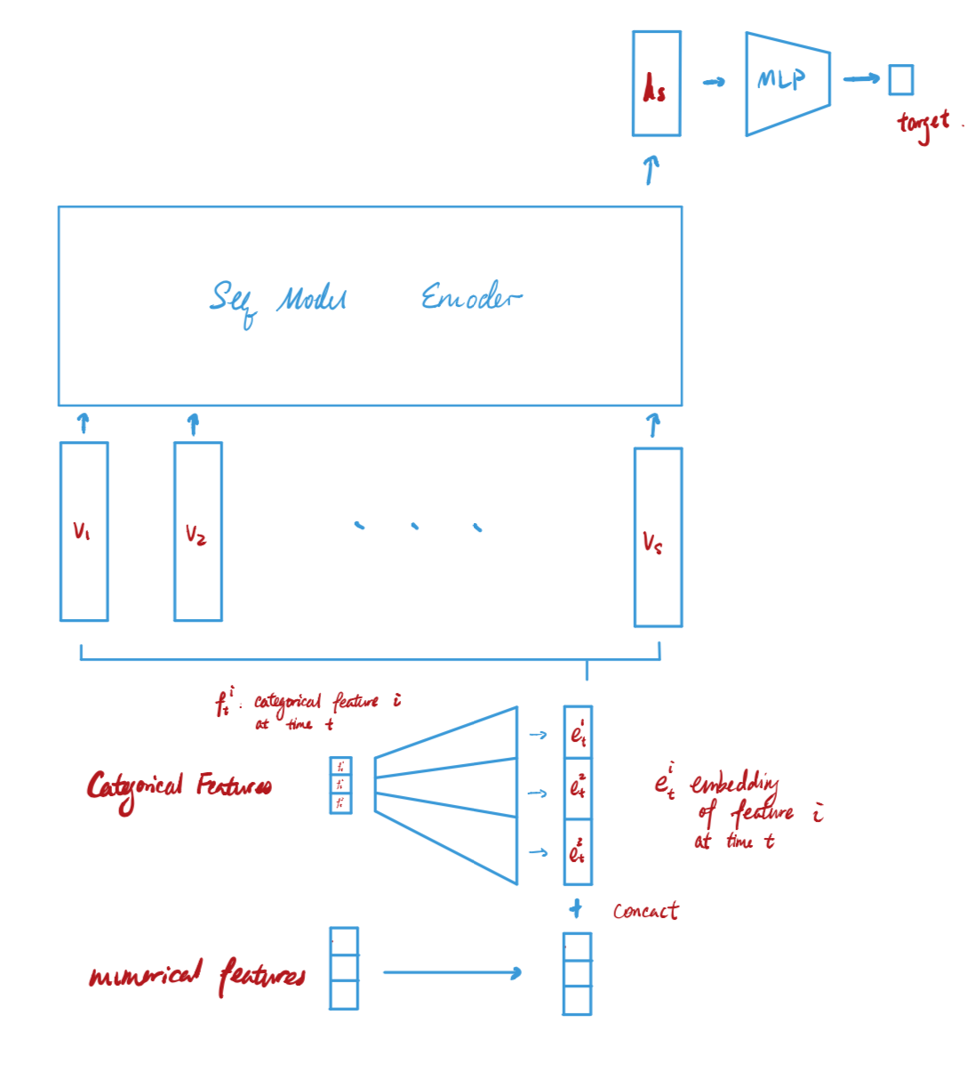
Model Architecture - TCN general information
TCN: Temporal Convolutional Networks
Autoregressive model works similar to RNN (Recurrent Neural Network)
TCN vs. RNNs (GRU, LSTM)
Achieves better and faster performances on many tasks.
More parallelized: faster training.
Lower memory requirement.
Long-term dependencies.
More detailed information for TCN can be found in the Appendix.
TCN
Notes:
Advantages over traditional autoregressive models:
ARIMA: forecasting
TCN: output a vector acts as a summary => can be used in anyway possible.
TCN vs. ARIMA
More flexible.
Automatic feature extractor, less engineering.
Long-term dependencies.

Slide 13
Model Architecture - My adaptations
Each user has a sequence of transactions.
For each user at each time step:
Encode categorical features into embeddings.
Concatenate embedded categorical features with numerical features.
Feed the sequence of vectors into a sequential encoder: TCN
Feed the output vector at the last time step into a multi-layer perceptron to predict target.
Current TCN has effective history = 32
TCN
Notes:
Embedding: a technique just like one-hot encoding, that converts categorical features into numerical features.
More flexible and practically used in NLP.

Slide 14
Content
Project Overview
Data
Model Architecture
Performance

Slide 15
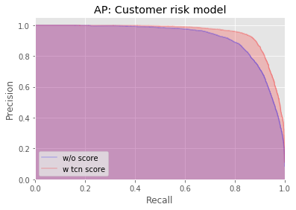
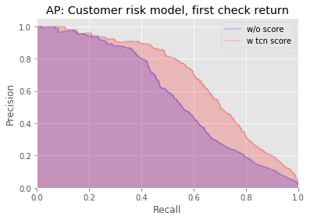
Performance - OOF - LGBM vs. TCN + LGBM
Customer Risk Model - Out-of-fold and grouped by borrower_id
A borrower can only appear in either train or validation data, but not both.
Average Precision: Area under the Precision-Recall curve
LGBM baseline: 0.893
TCN + LGBM: 0.927
TCN + LGBM outperforms when the nr_past_returns = 0, when catching initial fraud attempt.

Slide 16
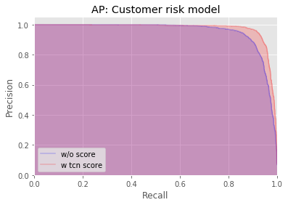
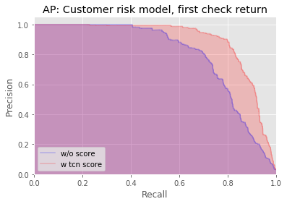
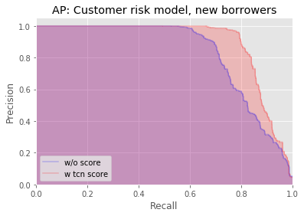
Performance - OOT - LGBM vs. TCN + LGBM
Customer Risk Model - Out-of-time
Average Precision: Area under the Precision-Recall curve
LGBM baseline: 0.986
TCN + LGBM: 0.993
TCN+LGBM outperforms when capturing initial fraud, and on new borrowers.

Slide 17
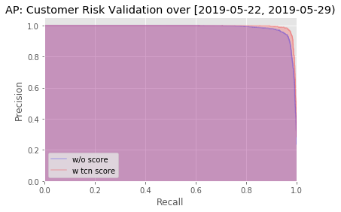
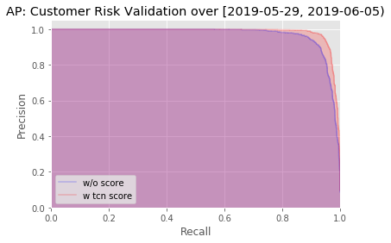
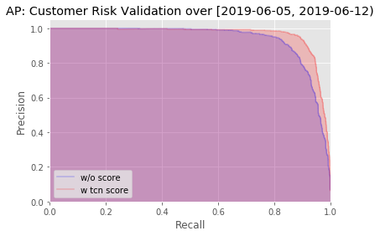
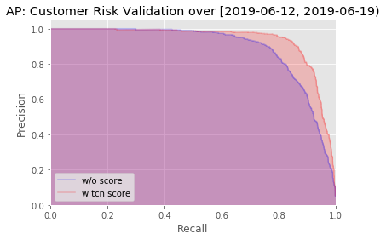
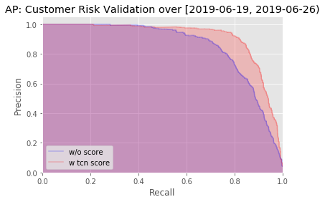
Performance - OOT - LGBM vs. TCN + LGBM
Customer Risk Model - Out-of-time segmented by time - weekly
Performances drops as time goes on -> need to refit periodically

Slide 18
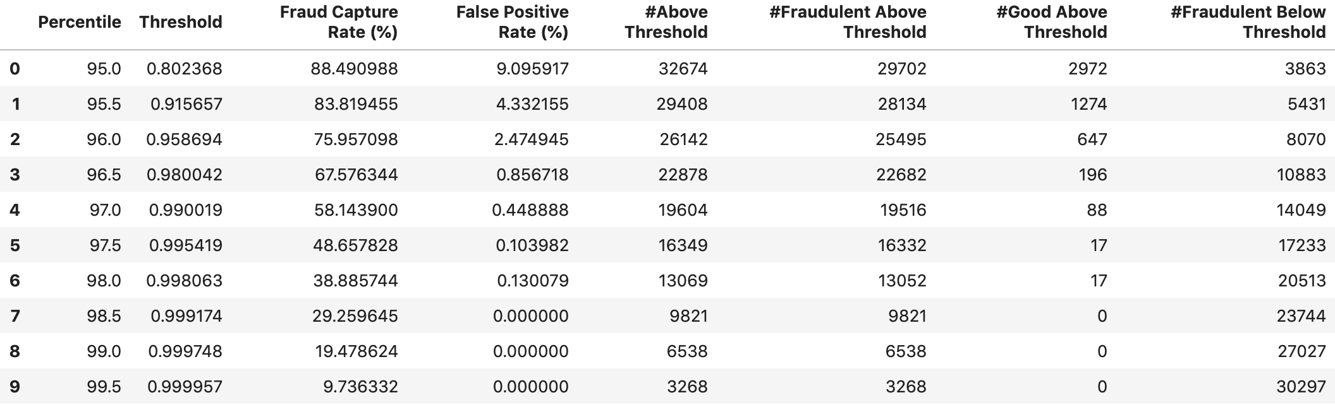
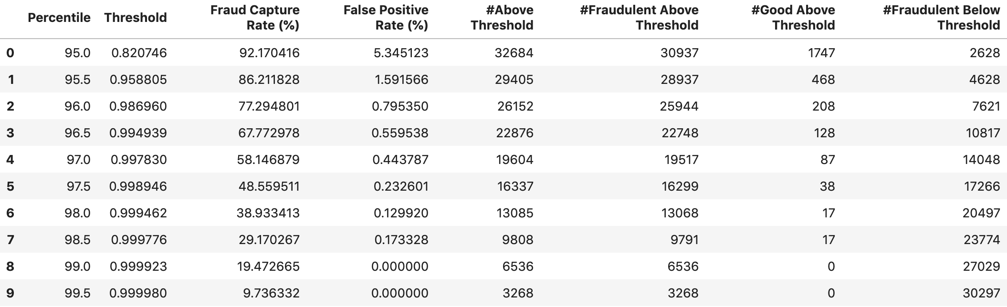
Performance
Performance on top 5 pctls
LGBM Baseline:
TCN + LGBM:

Slide 19
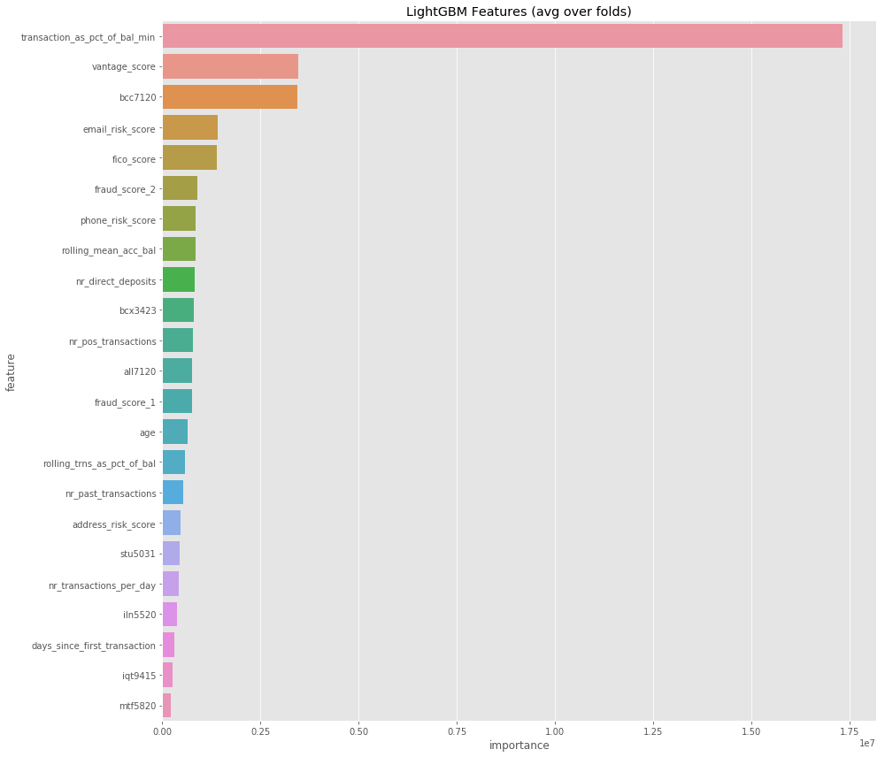
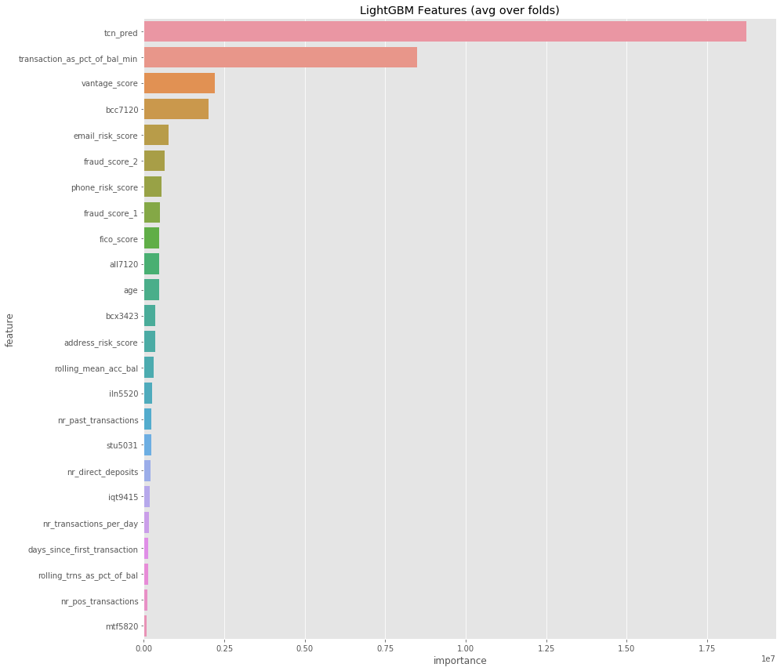
Feature Importance
LightGBM
TCN+LightGBM
Notes:
Bcc7120 - balance to credit ratio for bankcard trades

Slide 20
Thanks!
Any questions, comments, and suggestions?
Currently building an end-to-end TCN model that takes in the sequential features and tabular features at the same time.

Slide 21
Appendix!
Information on TCN:
Introduction of the TCN Architecture: https://medium.com/the-artificial-impostor/notes-understanding-tensorflow-part-3-7f6633fcc7c7
Original Paper: https://arxiv.org/pdf/1803.01271.pdf
Informative documentations: https://github.com/philipperemy/keras-tcn
Current TCN API:
https://gitlab.com/sofiinc/data-science-risk/sequential-models
Detailed Model Validation:
https://gitlab.com/sofiinc/data-science-risk/sequential-models/blob/include_stationary_features/TCN_v1/customer_risk_model_validation.ipynb

Slide 22
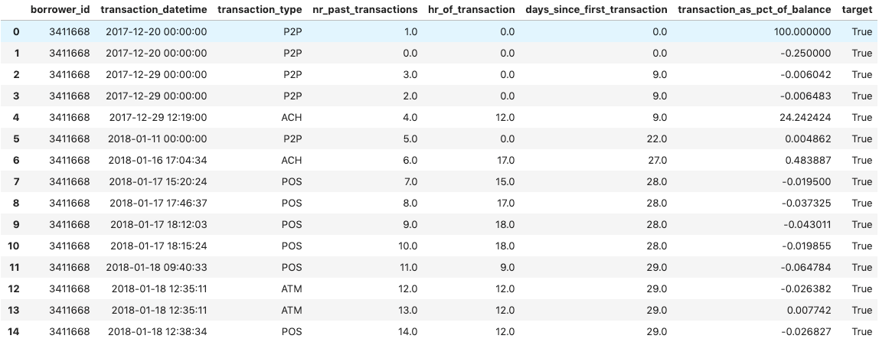
How does our TCN API work?

